Slide 2
Welcome
Plenty Advanced First Aid

Slide 3
House rules are:

Slide 4
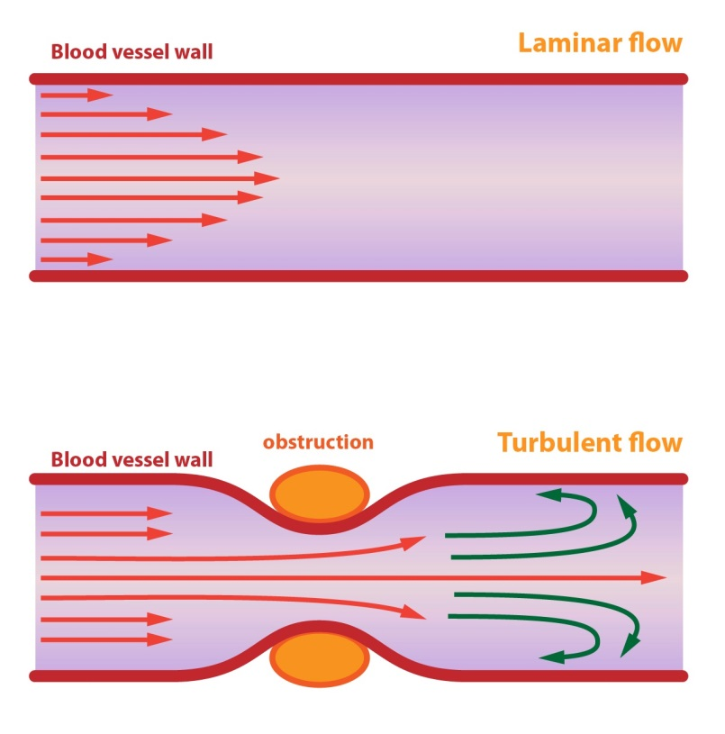
Terminology
Systolic
= Heart contracts
Diastolic
= Heart relaxes
Hypertension
= High blood pressure
Hypotension
= Low blood pressure
Korotkoff Sounds
= Russian Dude
Laminar flow
= Smooth flow
Turbulent flow
= With eddies

Slide 5
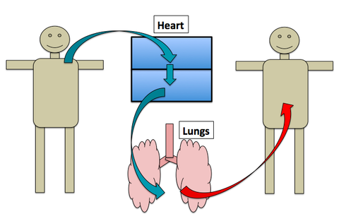
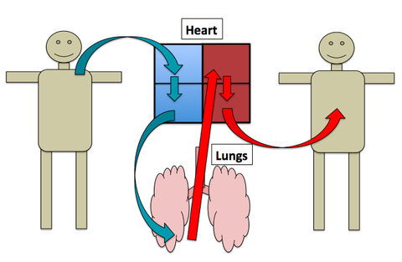
The human heart
2 pumps in 1

Slide 6
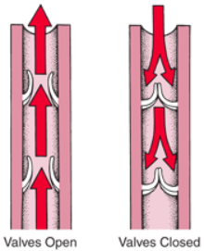
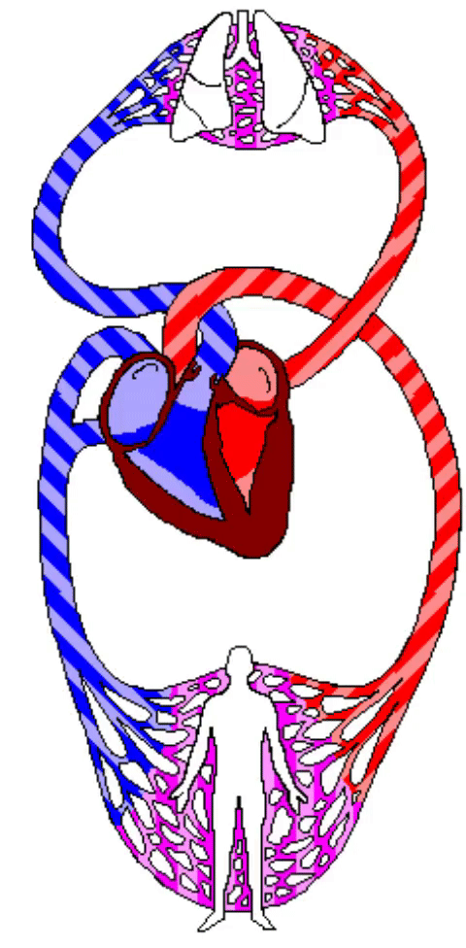
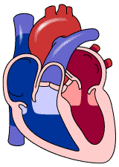
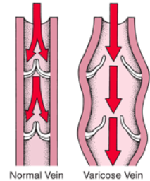
The human heart
2 pumps in 1
Atriums
Ventricles

Slide 7
What is blood pressure

Slide 8
Measuring blood pressure
Sounds of flow
Heart sounds
Sphygmomanometer
Sfigmo
120 mmHg over 80 mmHg
2.3 Psi over 1.5 Psi

Slide 9
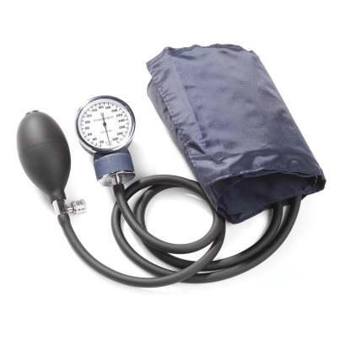
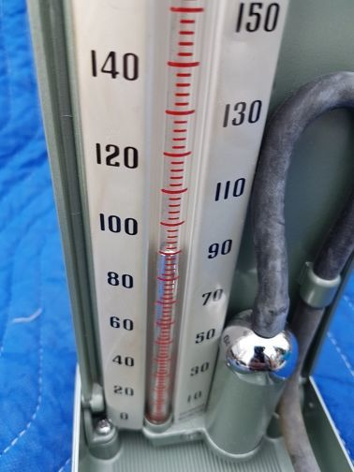
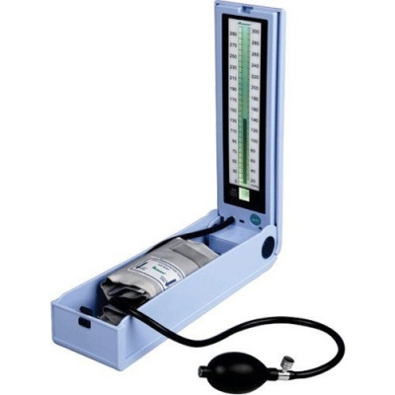
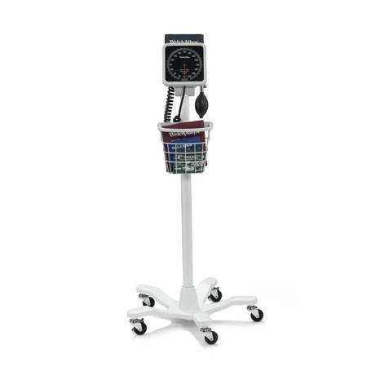
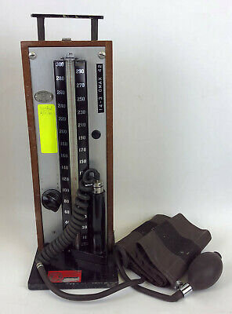
Measuring blood pressure
Sphygmomanometer
Sfigmo
120 mmHg over 80 mmHg
2.3 Psi over 1.5 Psi

Slide 10
What is perfusion

